Slide 1
Lecture 10: Climate Economics
Prof. Parthum
Environmental Economics Econ 475

Slide 2
Climate Change and Economics
Similar to many questions in environmental economics, climate economics aims to identify the relationship between the economy/welfare and climate.
But first, what do we mean by climate?
In general, we want to think about climate as a long-run conditions of the environment. A common window to define this is 30-years.
But climate isn’t just mean (average) conditions of the environment (temperature, precipitations, etc.), it can encompass much more than that.
Frequency or severity of storms (think recent upticks on tropical storms, etc.), frequency and severity of draught or heat waves, ecological conditions and ocean pH, the interconnectedness of these, and so so so much more.
Even if these things are “on average” the same (annually, etc.) , their affect on economic outcomes could be very different.
Things we don’t even know about yet (unknown unkowns).

Slide 3
Climate Change and Economics
Similar to many questions in environmental economics, climate economics aims to identify the relationship between the economy/welfare and climate.
But first, what do we mean by climate?
In general, we want to think about climate as a long-run conditions of the environment. A common window to define this is 30-years.
But climate isn’t just mean (average) conditions of the environment (temperature, precipitations, etc.), it can encompass much more than that.
Frequency or severity of storms (think recent upticks on tropical storms, etc.), frequency and severity of draught or heat waves, ecological conditions and ocean pH, the interconnectedness of these, and so so so much more.
Even if these things are “on average” the same (annually, etc.) , their affect on economic outcomes could be very different.
Things we don’t even know about yet (unknown unkowns).

Slide 4
Climate Change and Economics
Similar to many questions in environmental economics, climate economics aims to identify the relationship between the economy/welfare and climate.
But first, what do we mean by climate?
In general, we want to think about climate as a long-run conditions of the environment. A common window to define this is 30-years.
But climate isn’t just mean (average) conditions of the environment (temperature, precipitations, etc.), it can encompass much more than that.
Frequency or severity of storms (think recent upticks on tropical storms, etc.), frequency and severity of draught or heat waves, ecological conditions and ocean pH, the interconnectedness of these, and so so so much more.
Even if these things are “on average” the same (annually, etc.) , their affect on economic outcomes could be very different.
Things we don’t even know about yet (unknown unkowns).

Slide 5
Climate Change and Economics
Similar to many questions in environmental economics, climate economics aims to identify the relationship between the economy/welfare and climate.
But first, what do we mean by climate?
In general, we want to think about climate as a long-run conditions of the environment. A common window to define this is 30-years.
But climate isn’t just mean (average) conditions of the environment (temperature, precipitations, etc.), it can encompass much more than that.
Frequency or severity of storms (think recent upticks on tropical storms, etc.), frequency and severity of draught or heat waves, ecological conditions and ocean pH, the interconnectedness of these, and so so so much more.
Even if these things are “on average” the same (annually, etc.) , their affect on economic outcomes could be very different.
Things we don’t even know about yet (unknown unkowns).

Slide 6
Climate Change and Economics
Similar to many questions in environmental economics, climate economics aims to identify the relationship between the economy/welfare and climate.
But first, what do we mean by climate?
In general, we want to think about climate as a long-run conditions of the environment. A common window to define this is 30-years.
But climate isn’t just mean (average) conditions of the environment (temperature, precipitations, etc.), it can encompass much more than that.
Frequency or severity of storms (think recent upticks on tropical storms, etc.), frequency and severity of draught or heat waves, ecological conditions and ocean pH, the interconnectedness of these, and so so so much more.
Even if these things are “on average” the same (annually, etc.) , their affect on economic outcomes could be very different.
Things we don’t even know about yet (unknown unkowns).

Slide 7
Climate Change and Economics
Similar to many questions in environmental economics, climate economics aims to identify the relationship between the economy/welfare and climate.
But first, what do we mean by climate?
In general, we want to think about climate as a long-run conditions of the environment. A common window to define this is 30-years.
But climate isn’t just mean (average) conditions of the environment (temperature, precipitations, etc.), it can encompass much more than that.
Frequency or severity of storms (think recent upticks on tropical storms, etc.), frequency and severity of draught or heat waves, ecological conditions and ocean pH, the interconnectedness of these, and so so so much more.
Even if these things are “on average” the same (annually, etc.) , their affect on economic outcomes could be very different.
Things we don’t even know about yet (unknown unkowns).

Slide 8
The Ideal Experiment
We’ve talked a lot about how Randomized Control Trials (RCTs) are the gold standard for identifying causal relationships. What would that experiment (RCT) look like in the case of estimating the causal relationship between climate and the economy?
Ideal: Two earths (or many), we randomly pump a bunch of carbon dioxide into the atmosphere of one to change the climate. Examine the differences between the treatment and control earths over the next several hundred years.
What we have: One earth and some quasi-experimental econometrics methods that identify model parameters from variation in historical observation (either cross-sectional or panel).

Slide 9
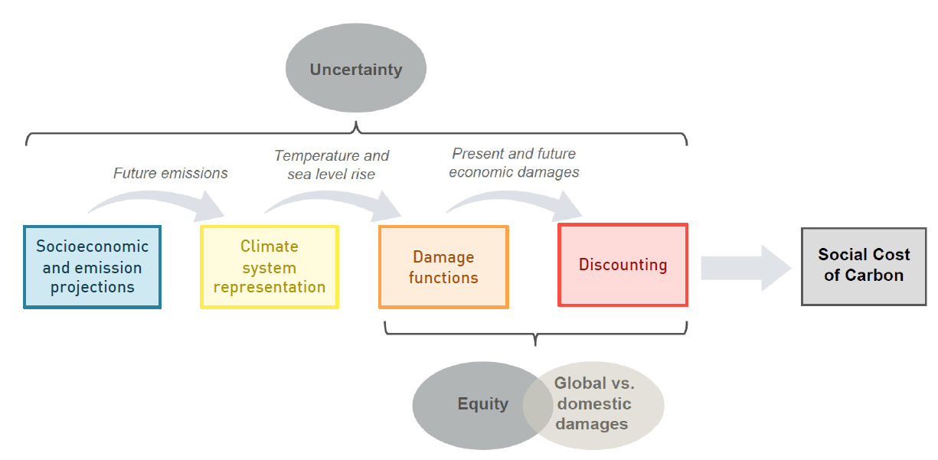
The 4 Main Climate-Economy Modules
This part, the SCC, is the difference between the baseline model and the model with an extra ton of carbon dioxide

Slide 10
Ambitious Research Agenda
So, the objective is to identify the relationship between the economy/welfare and the climate, using more than 30-years of data, taking into account all interactions between sectors, market and nonmarket, while controlling for baseline differences and trends in our data. Then, once we have this relationship estimated, we need to project economic growth, population/life expectancy, greenhouse gas emissions, then take into account adaptation, mitigation, oh, and uncertainty in all of these things…
Recognizing that this is a very difficult task, researchers in the 1970’s started wondering if we could even place a sign (positive or negative) on the relationship between the economy and climate. This was done in an Integrated Assessment Model (IAM) framework.
Once calibrated, IAMs allow researchers to explore empirical relationships between model components and their feedbacks.

Slide 11
Ambitious Research Agenda
So, the objective is to identify the relationship between the economy/welfare and the climate, using more than 30-years of data, taking into account all interactions between sectors, market and nonmarket, while controlling for baseline differences and trends in our data. Then, once we have this relationship estimated, we need to project economic growth, population/life expectancy, greenhouse gas emissions, then take into account adaptation, mitigation, oh, and uncertainty in all of these things…
Recognizing that this is a very difficult task, researchers in the 1970’s started wondering if we could even place a sign (positive or negative) on the relationship between the economy and climate. This was done in an Integrated Assessment Model (IAM) framework.
Once calibrated, IAMs allow researchers to explore empirical relationships between model components and their feedbacks.

Slide 12
Simplifying Assumptions for the Climate and Damage Modules
Because estimating the relationship between climate and the economy is such a heavy lift, some simplifying assumptions have been useful.
Global mean surface temperature (GMST) is commonly used as a sufficient statistic for climate.
In addition, the dimensionality of the economy also needed to be reduced. To do so, Gross Domestic Product (GDP) if often used to represent the economy and welfare.
These two assumptions brought the dimensionality of the problem down to a more manageable size.

Slide 13
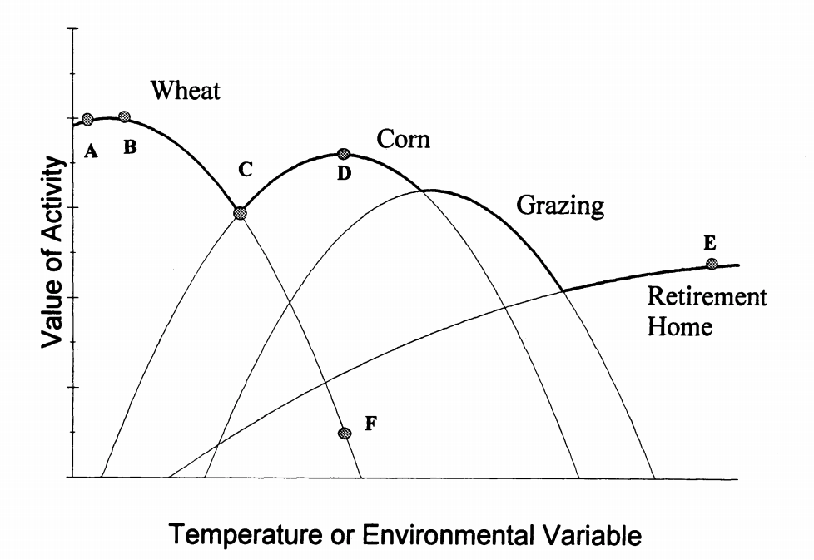
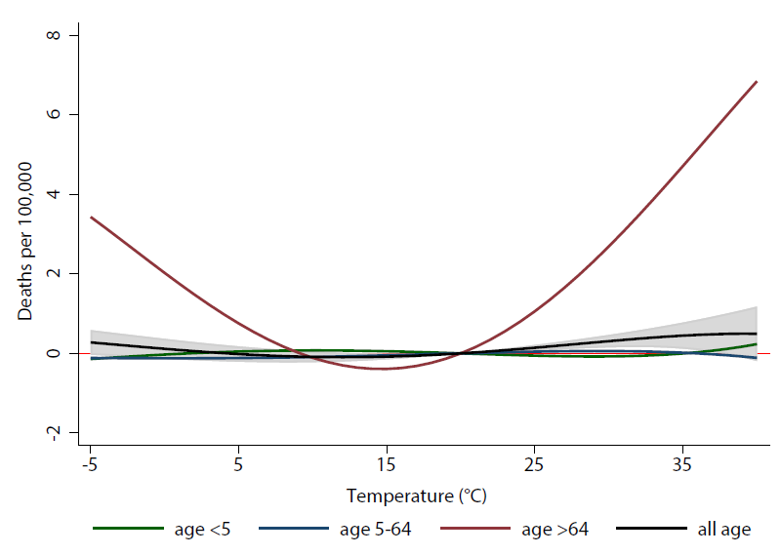
There is usually some optimal temperature
Optimal temperature for land use
Optimal temperature for health
Source: Mendelsohn et al. 1994
Source: Carleton et al. 2022

Slide 14
Naïve Climate Economics – Mortality
Example: What is the effect of climate on global mortality?
Very hot and very cold temperatures are both bad for mortality, what's the overall effect of climate change?
Difficult to account for adaptation: people will migrate, buy air conditioning, etc.
Failing to account for adaptation will overstate the effect of climate change. See Carleton et al. 2022 for a nice empirical treatment of mortality risk adaptation.

Slide 15
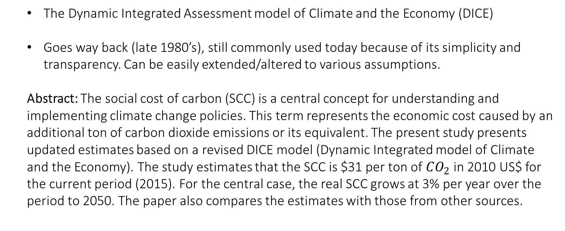
Revisiting the social cost of carbon
By: Nordhaus (2017)
The Dynamic Integrated Assessment model of Climate and the Economy (DICE)
Goes way back (late 1980’s), still commonly used today because of its simplicity and transparency. Can be easily extended/altered to various assumptions.
Abstract: The social cost of carbon (SCC) is a central concept for understanding and implementing climate change policies. This term represents the economic cost caused by an additional ton of carbon dioxide emissions or its equivalent. The present study presents updated estimates based on a revised DICE model (Dynamic Integrated model of Climate and the Economy). The study estimates that the SCC is $31 per ton of $CO_{2}$ in 2010 US$ for the current period (2015). For the central case, the real SCC grows at 3% per year over the period to 2050. The paper also compares the estimates with those from other sources.

Slide 16
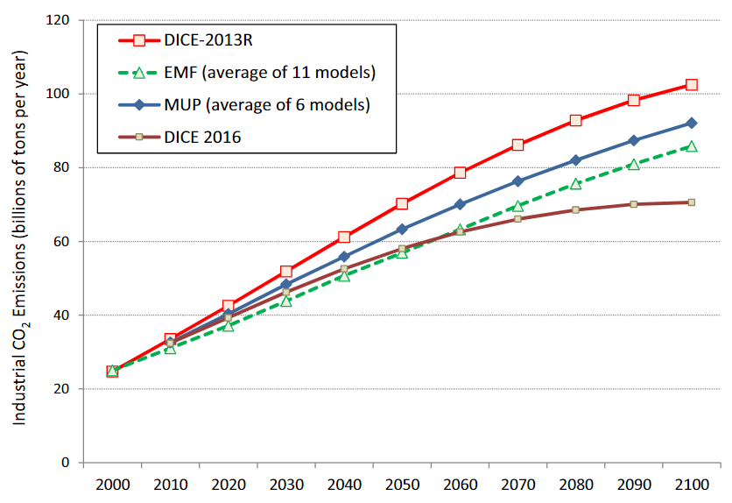
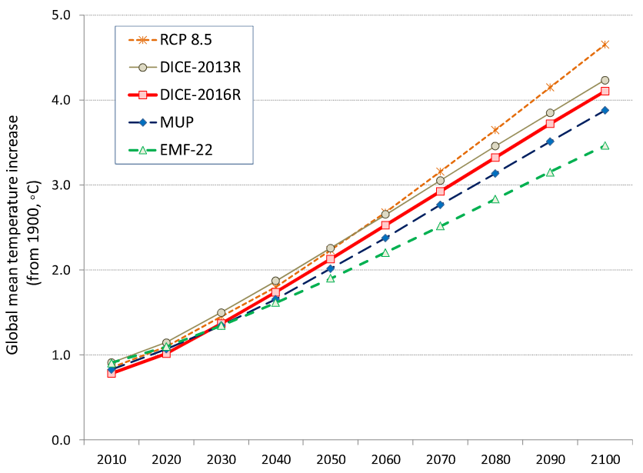
Revisiting the social cost of carbon
By: Nordhaus (2017)

Slide 17
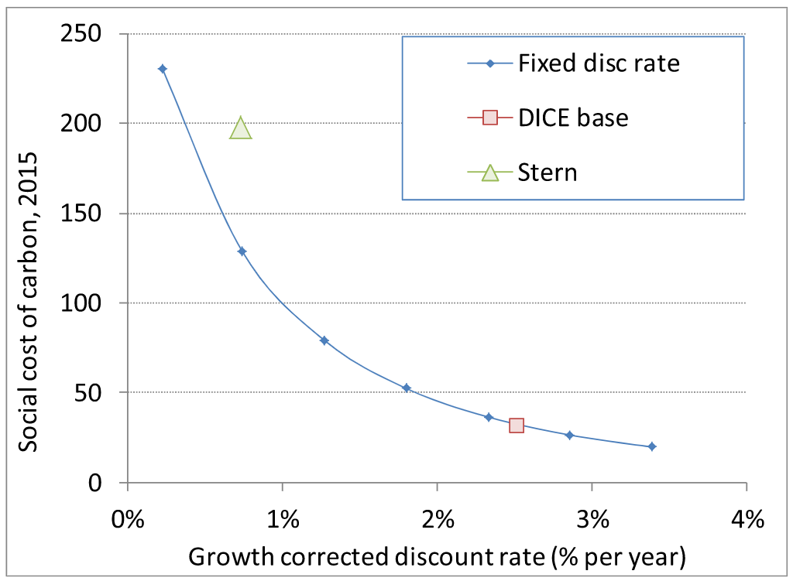
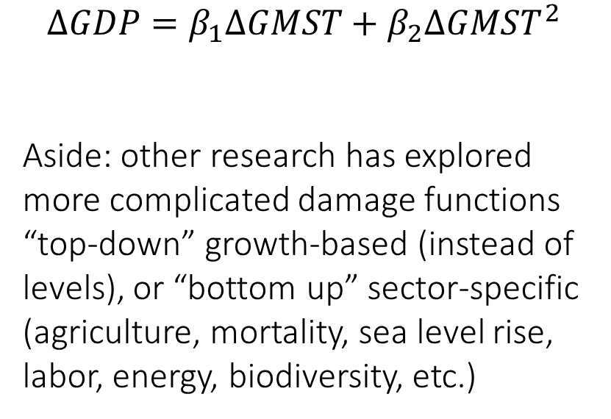
Revisiting the social cost of carbon
By: Nordhaus (2017)
$$ΔGDP=β_{1}ΔGMST+β_{2}ΔGMST^{2}$$
Aside: other research has explored more complicated damage functions “top-down” growth-based (instead of levels), or “bottom up” sector-specific (agriculture, mortality, sea level rise, labor, energy, biodiversity, etc.)

Slide 18
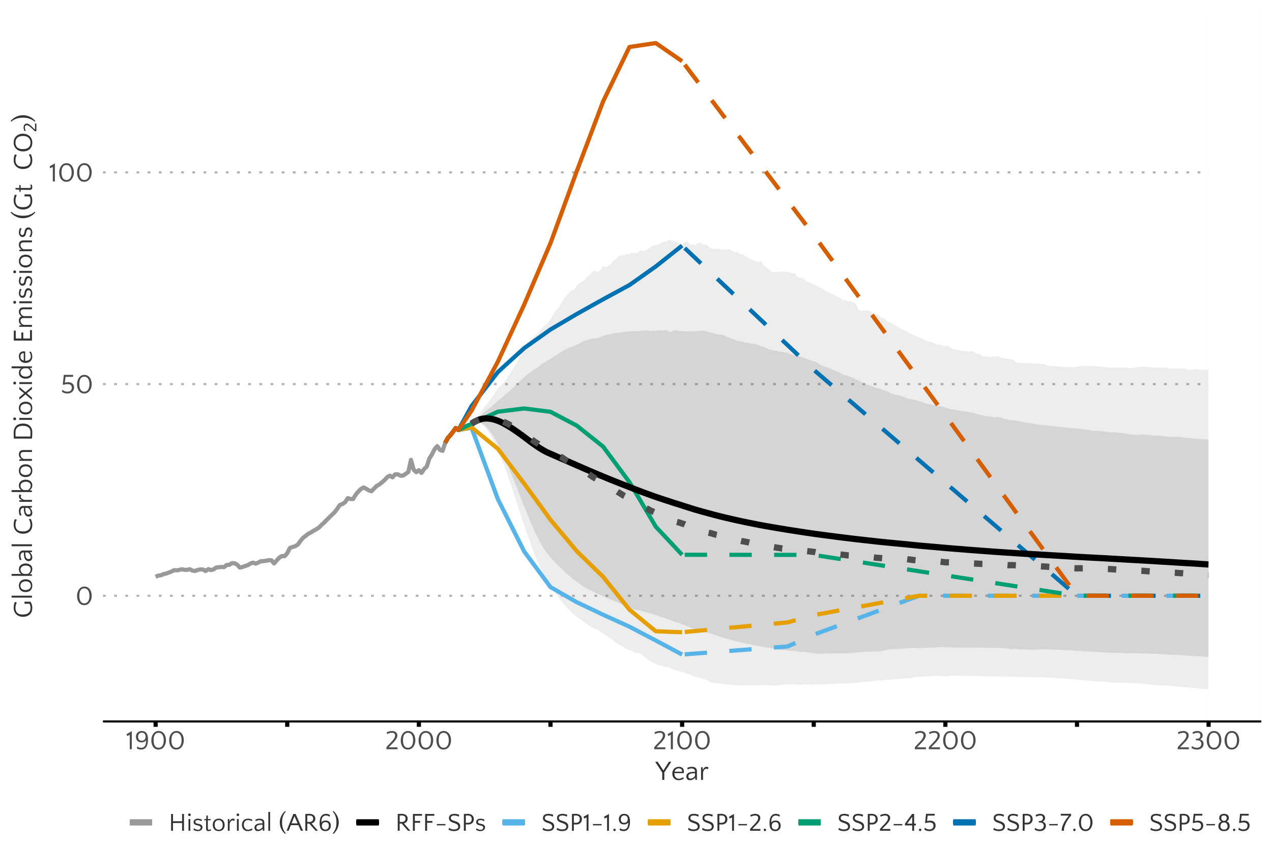
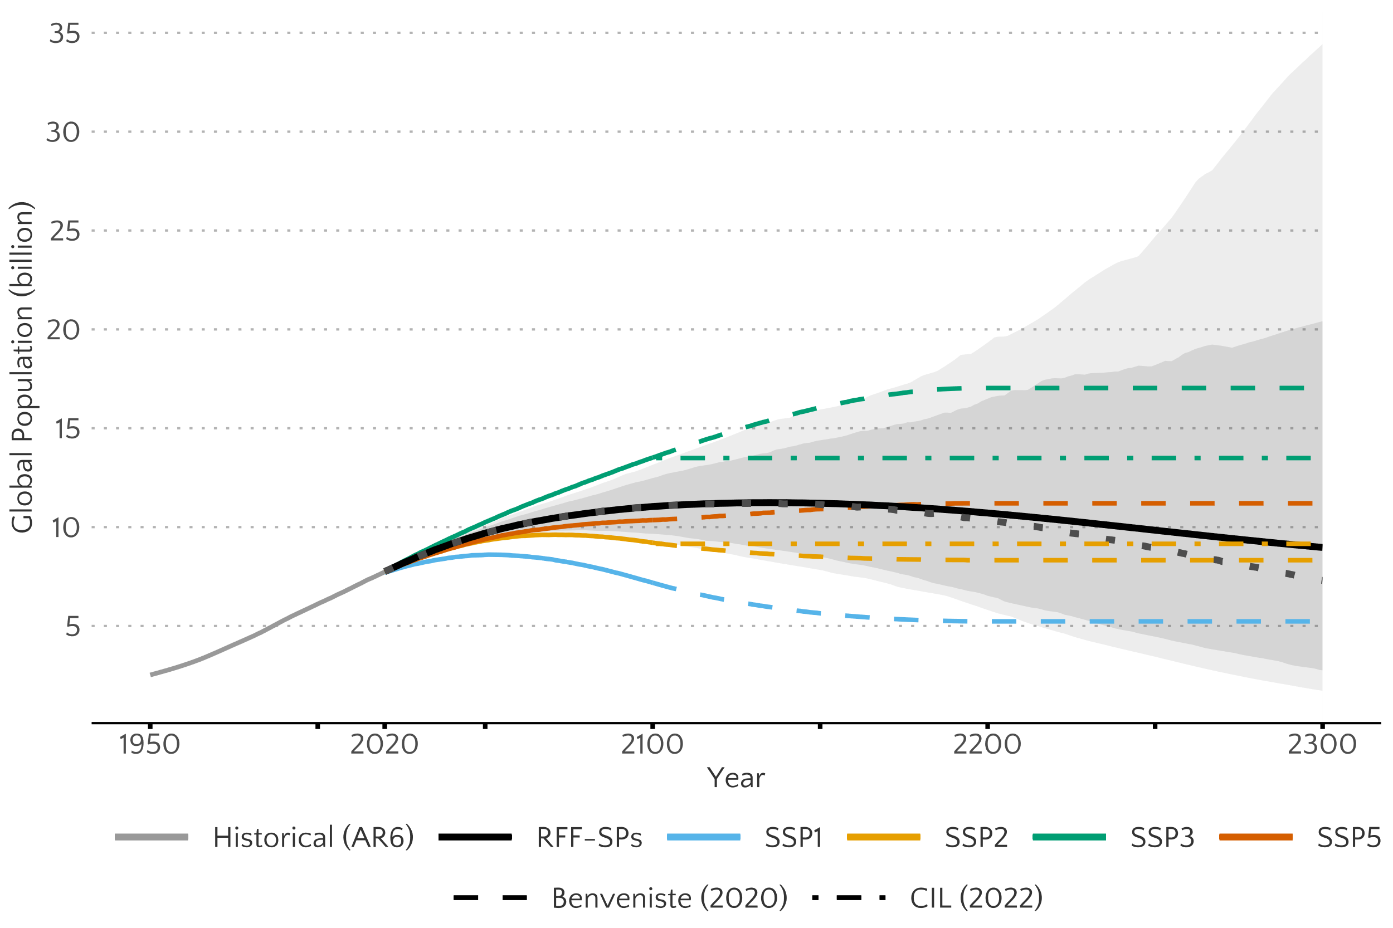
Life Beyond DICE - Rennert et al. (2022)
Statistical probabilistic growth scenarios linked to emissions

Slide 19
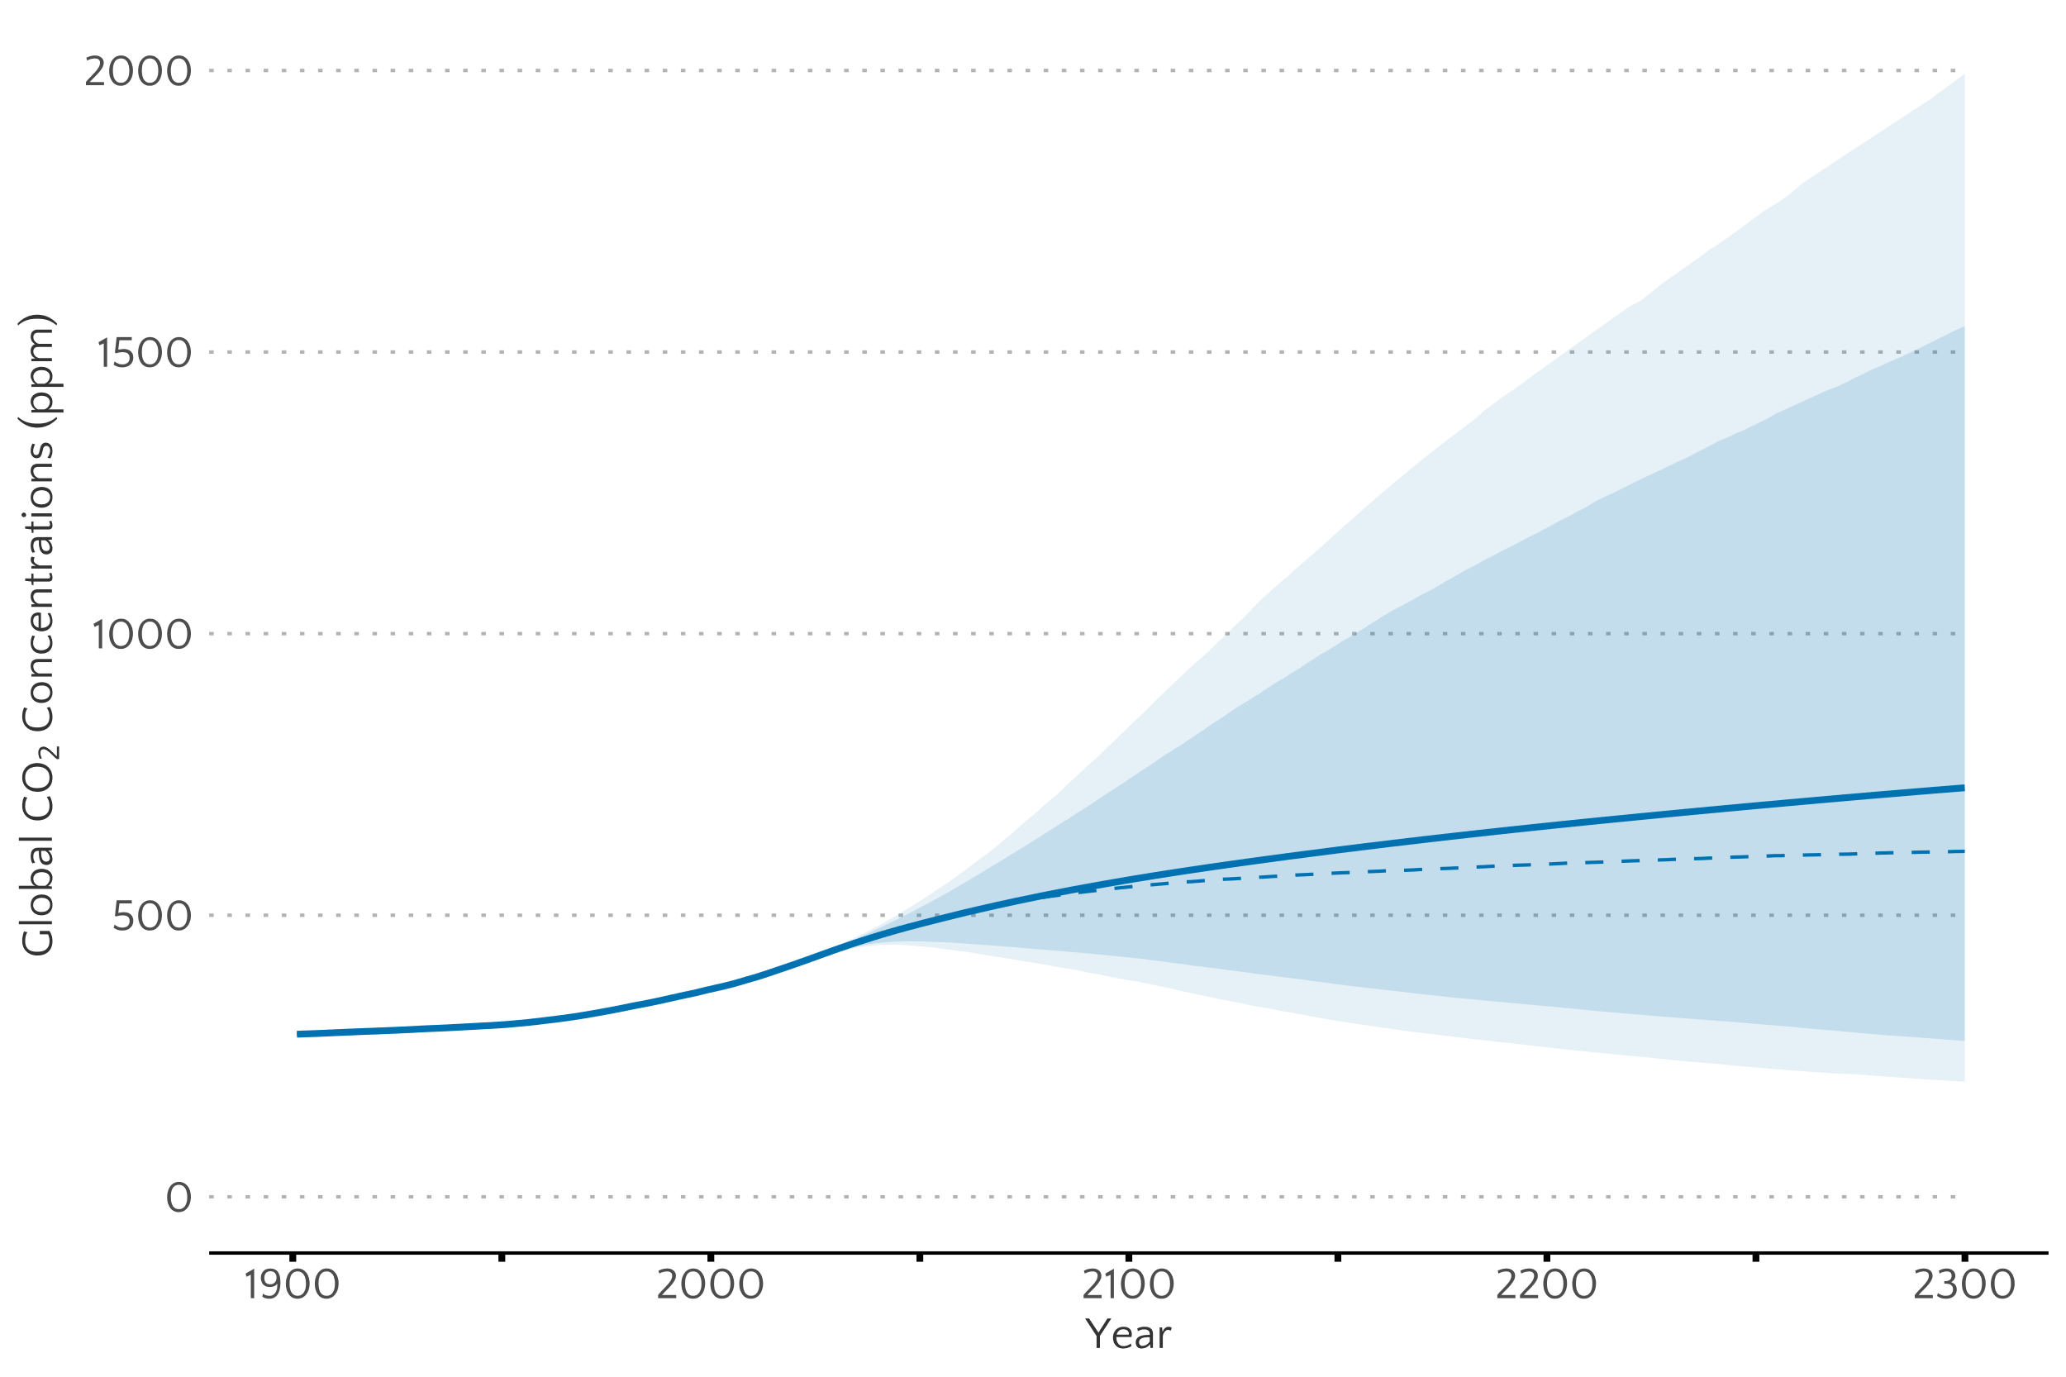
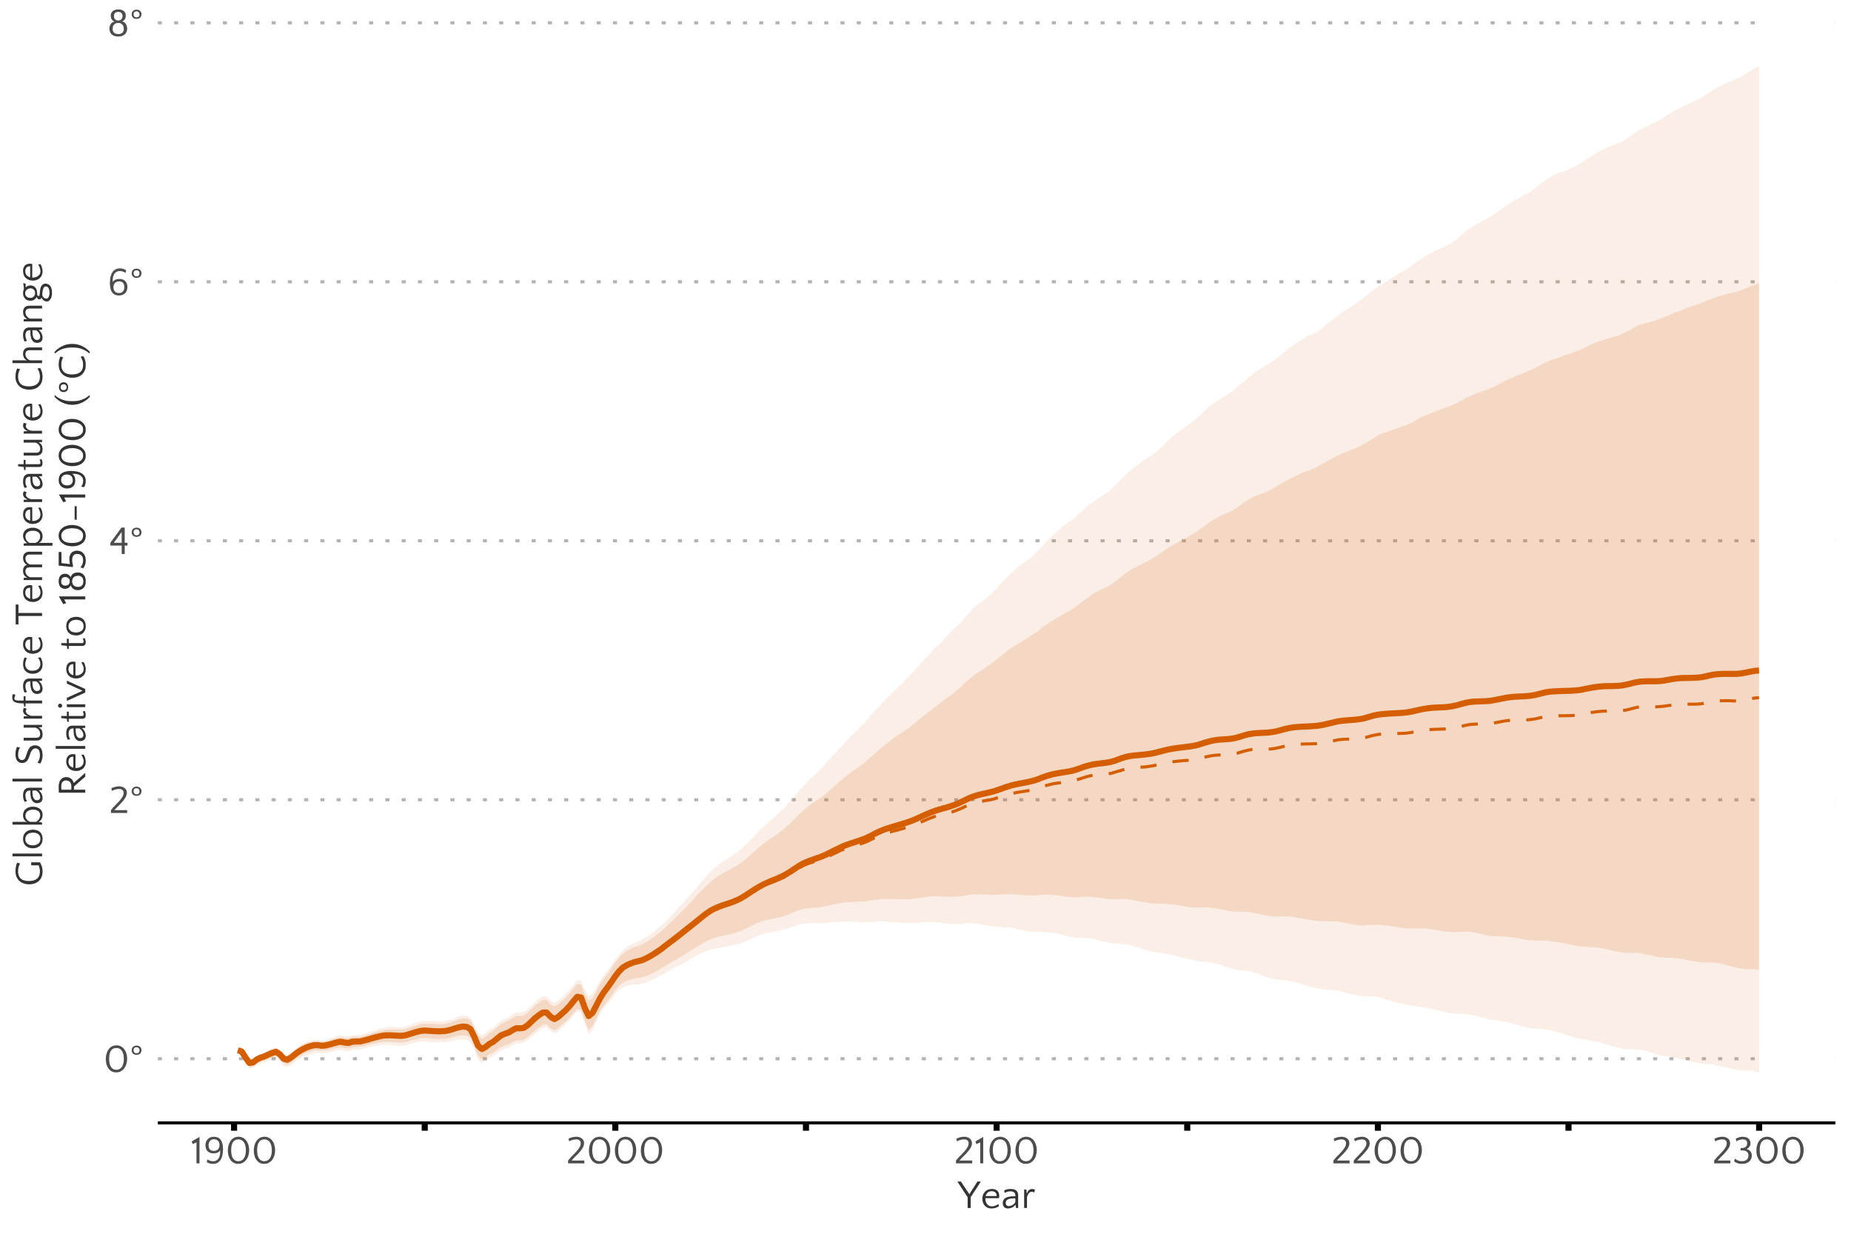
Life Beyond DICE - Rennert et al. (2022)
Reduced complexity climate systems model – FaIR1.6

Slide 20
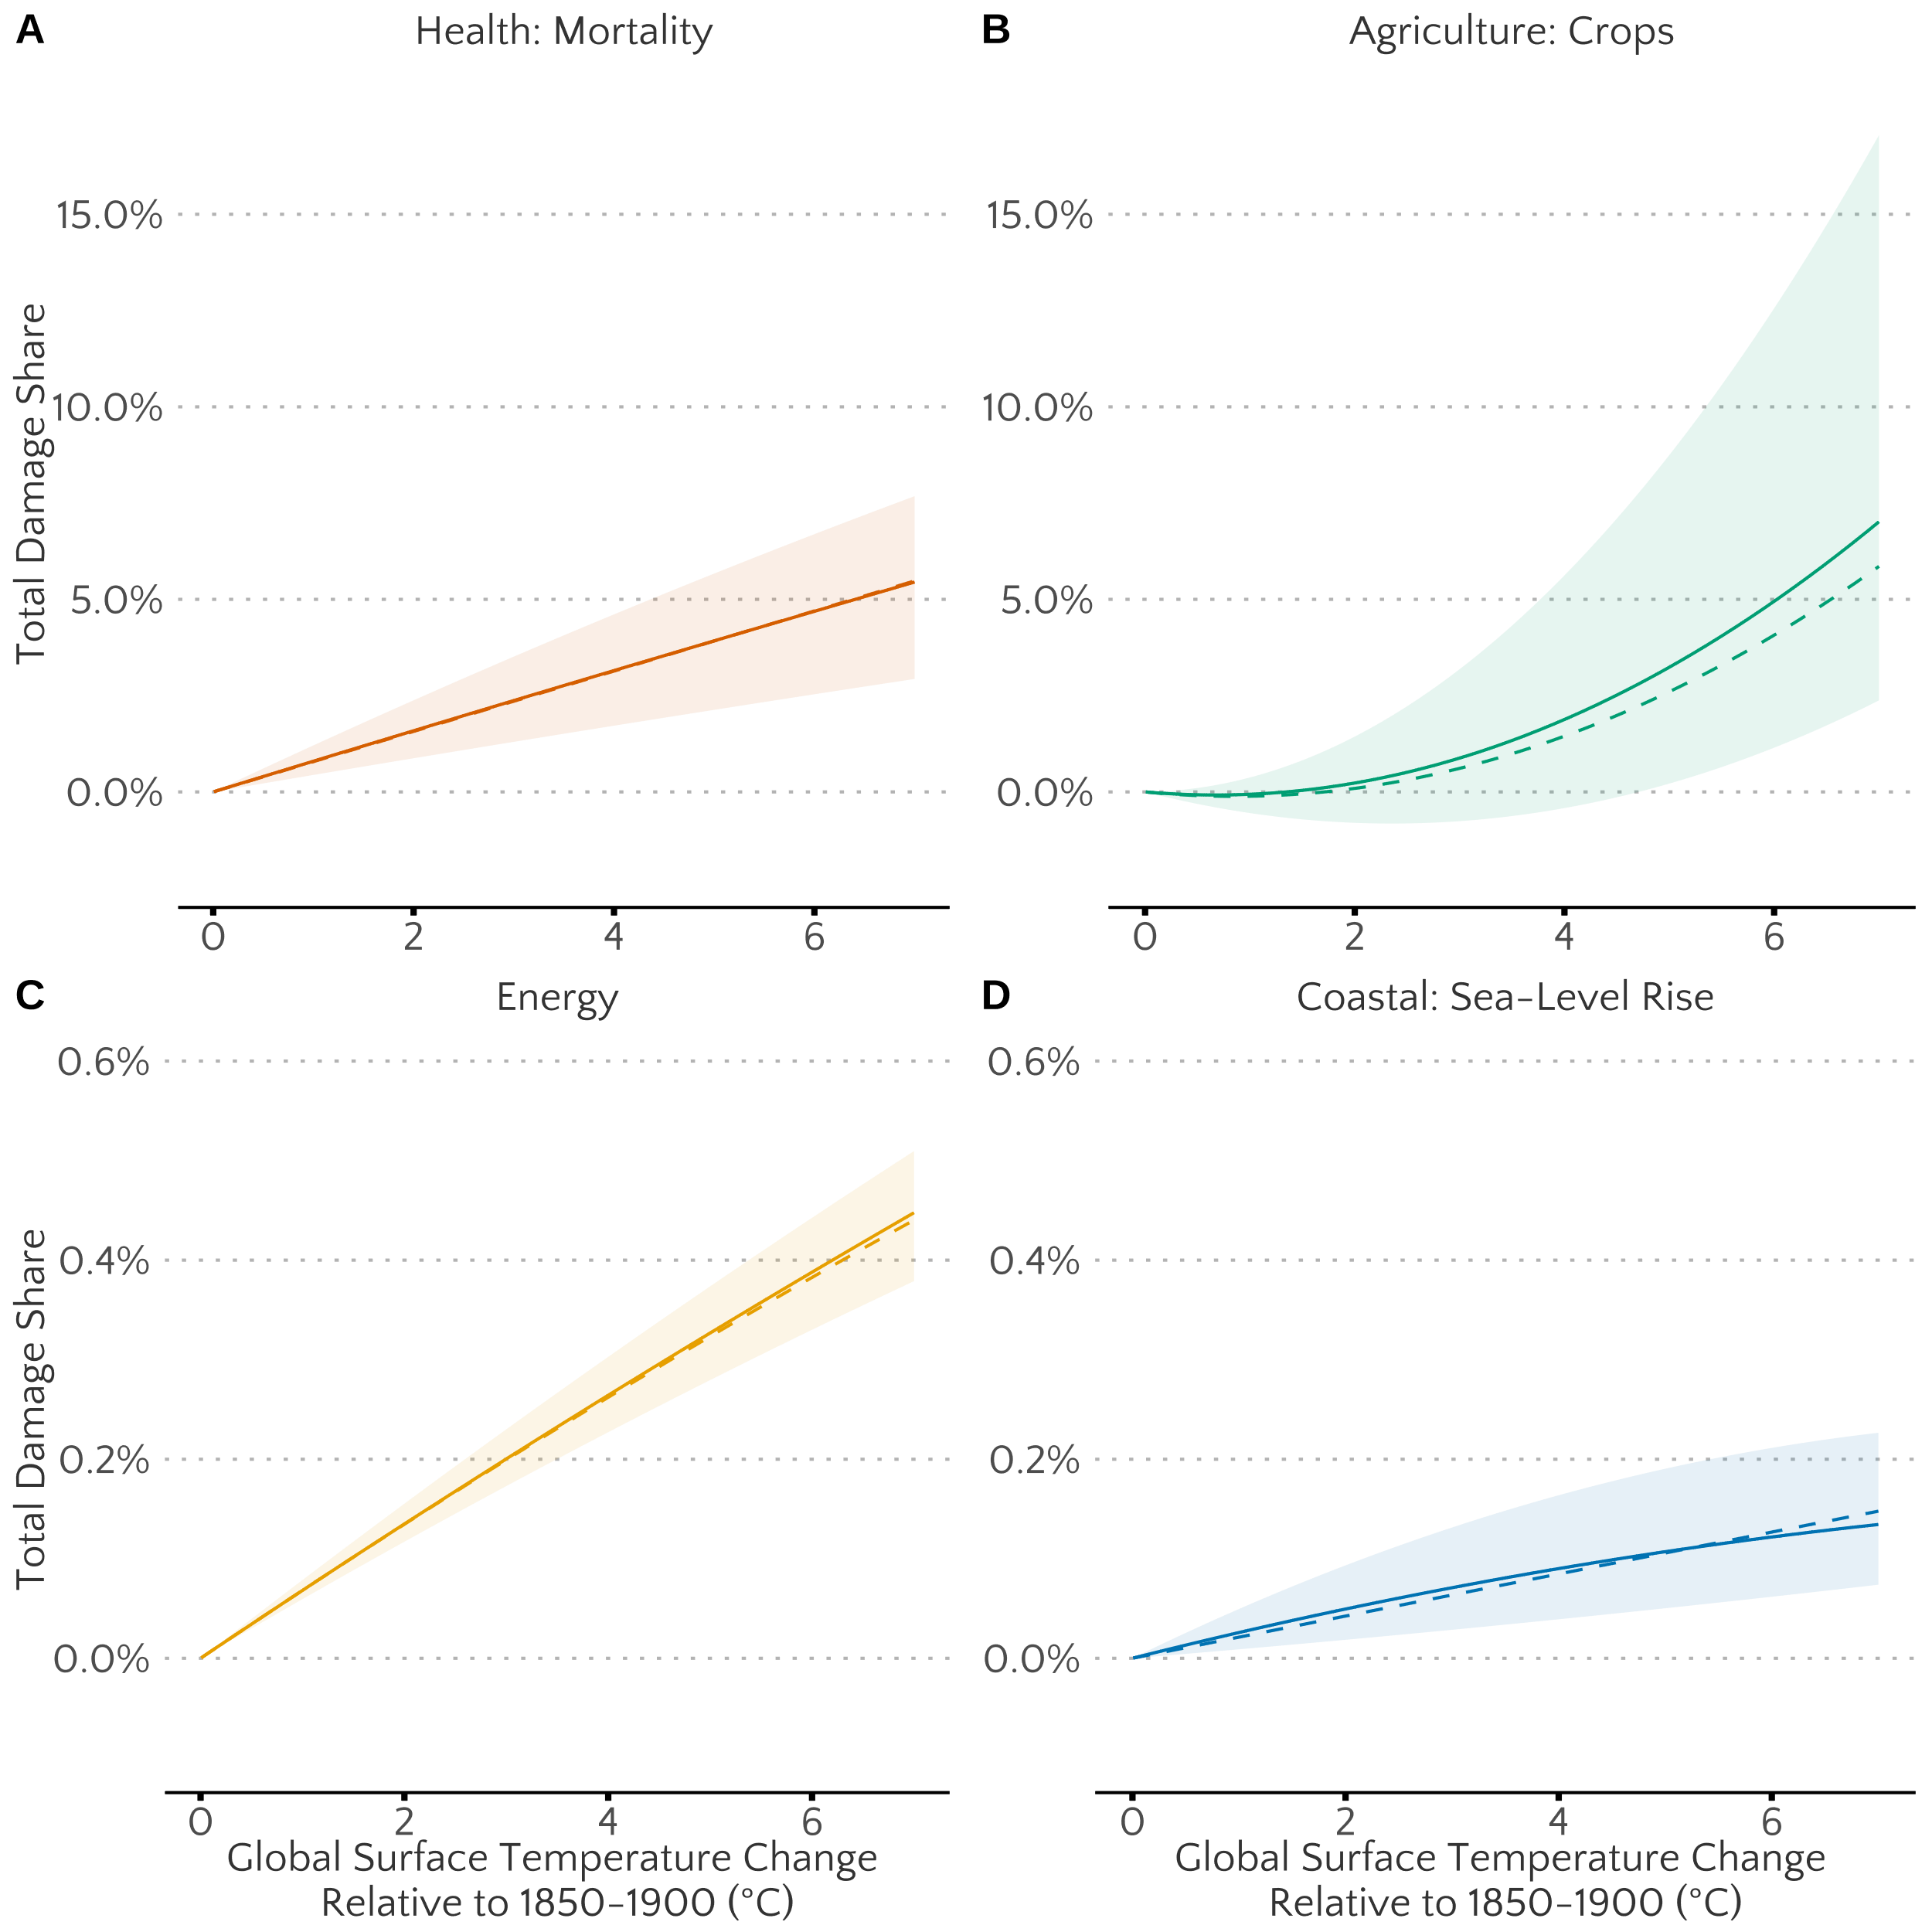
Life Beyond DICE - Rennert et al. (2022)
Four-sector damage function at the country-level (184 regions)

Slide 21
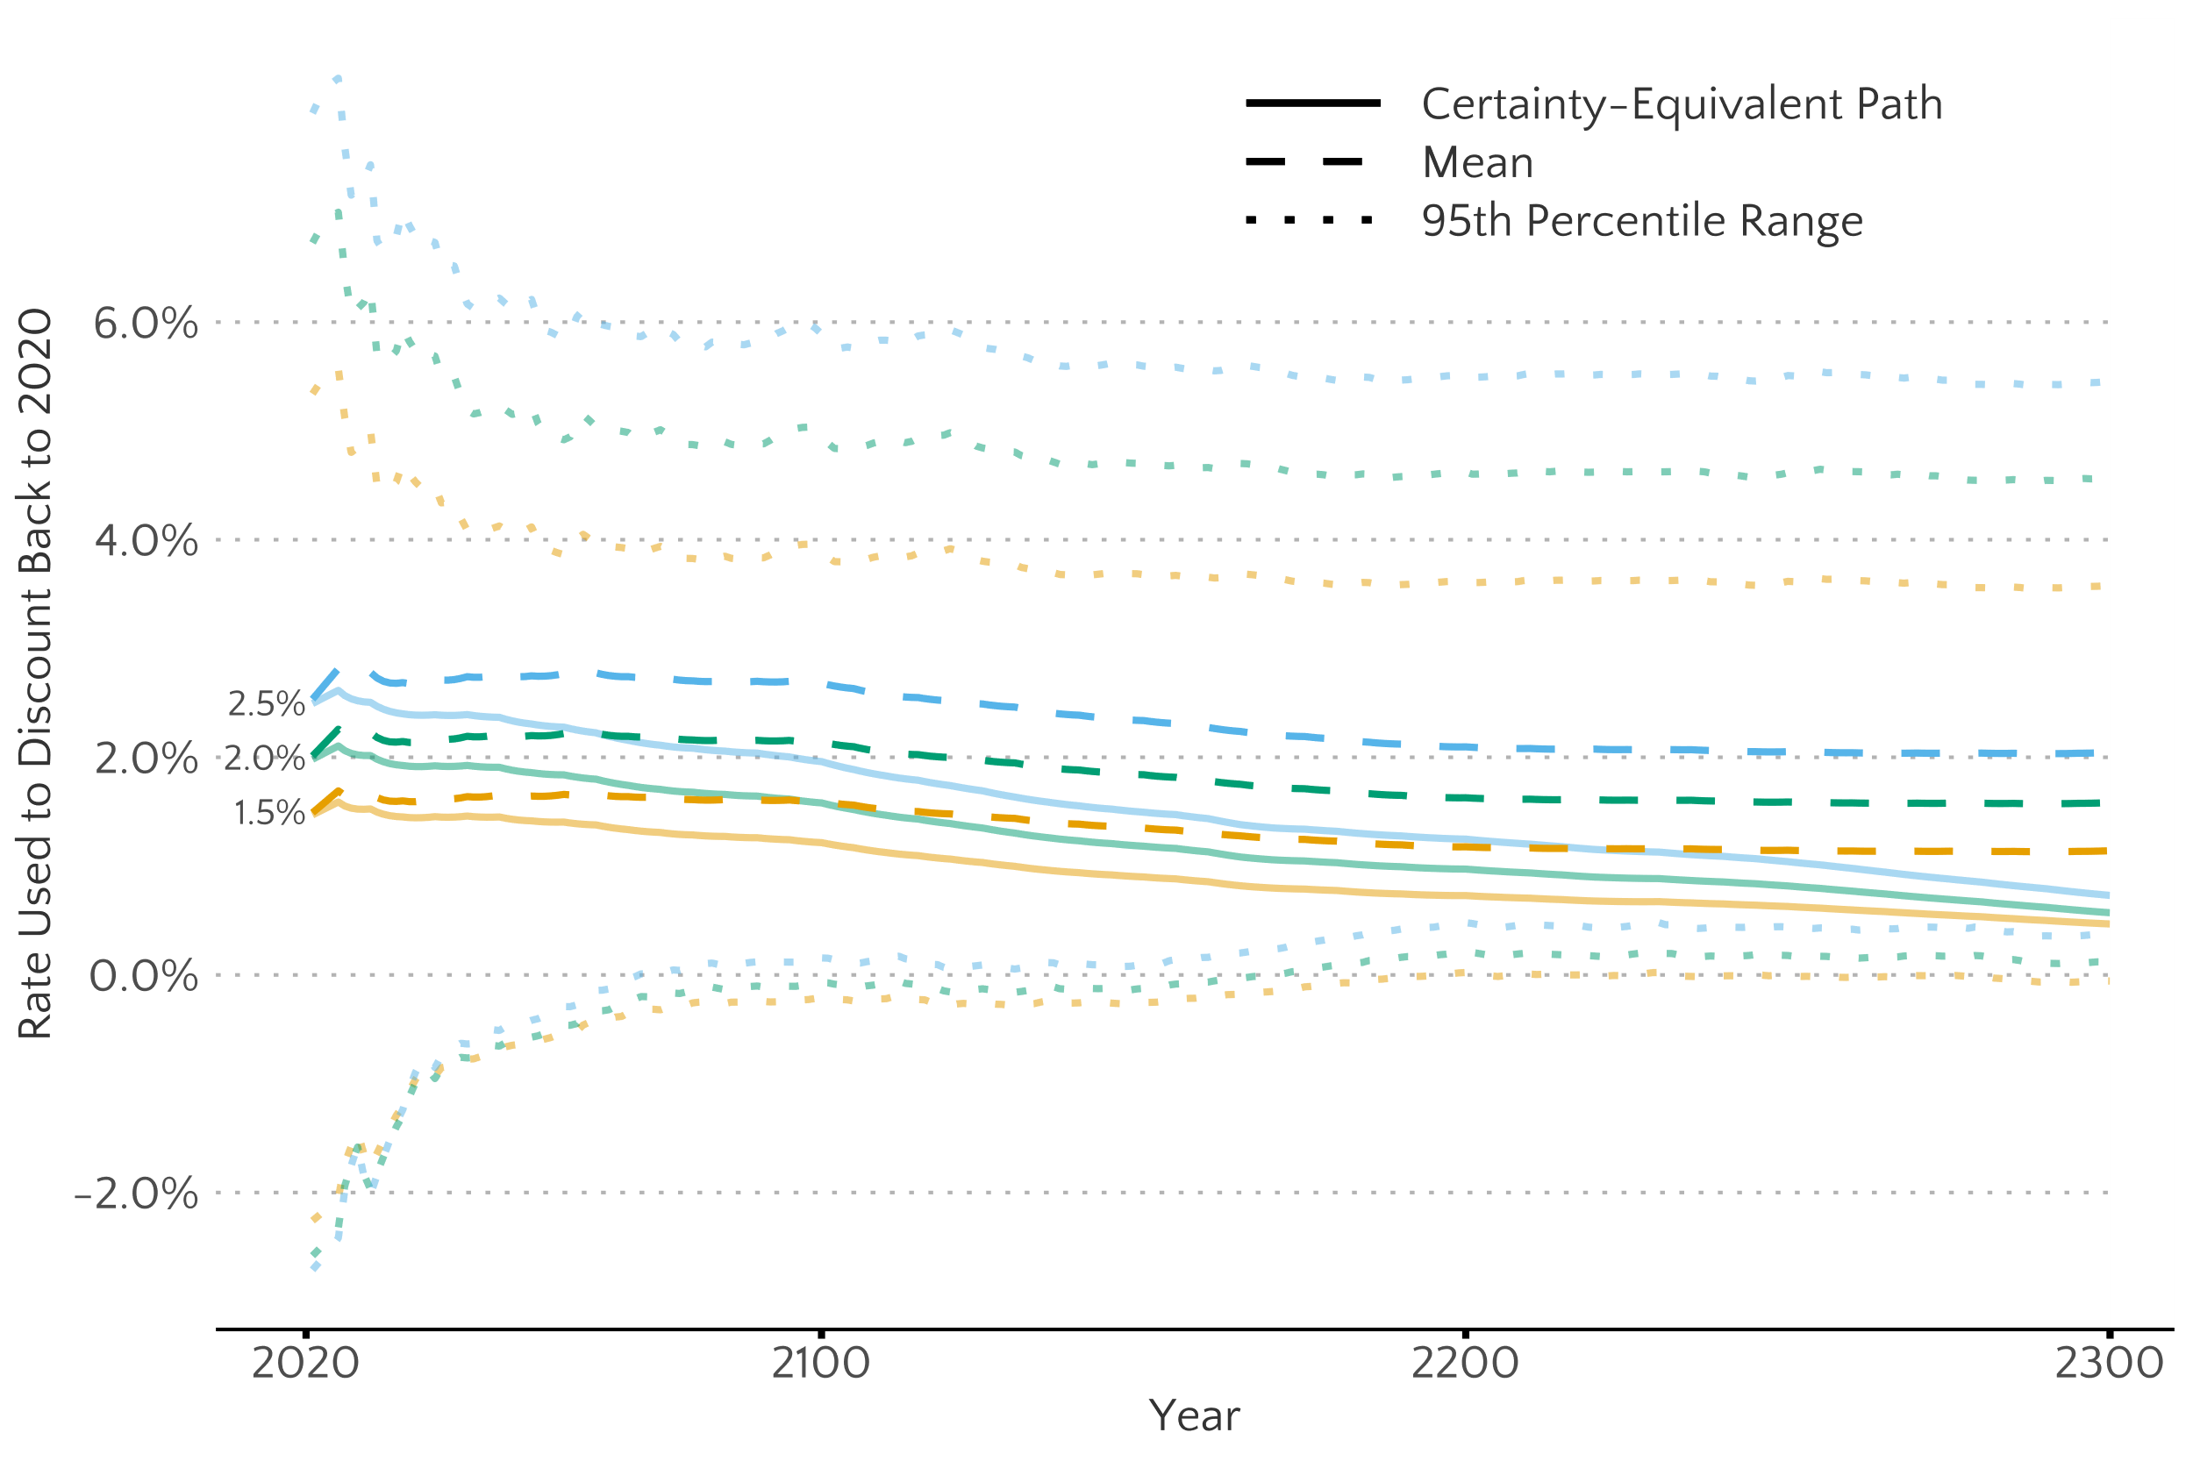
Life Beyond DICE - Rennert et al. (2022)
Dynamic growth-consistent discount rate

Slide 22
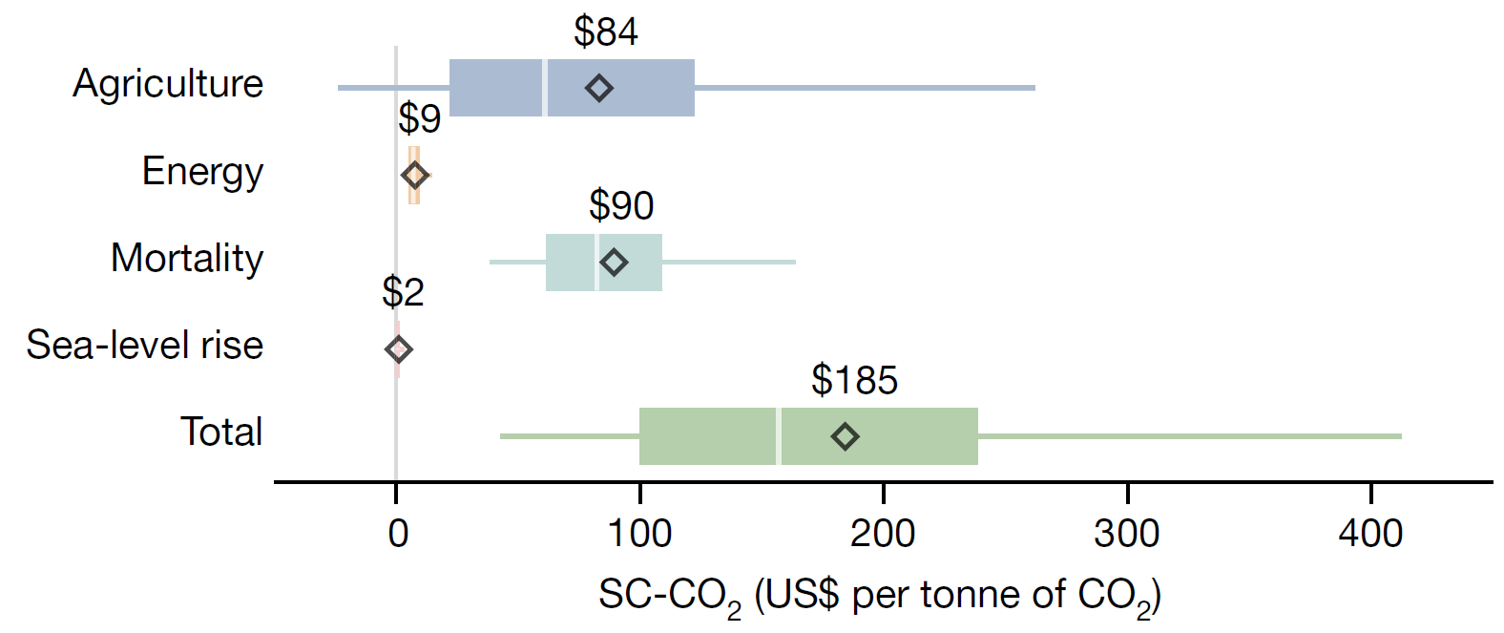
Life Beyond DICE - Rennert et al. (2022)
A social cost of carbon dioxide that is thrice the USG estimate

Slide 23
Next class
Accounting for Natural Capital with Natural Capital Accounting:
K&O (textbook) Chapter 11
An Almost Practical Step Toward Sustainability (Solow Monograph)
Reminder: Case Study #1 – due tomorrow! September 27th by 11:59pm
Heads up: Case Study #2– due Oct 9th by 11:59pm

